Slide 1


2023-S MIS-637-B
DATA ANALYTICS AND MACHINE LEARNING

Slide 2


GROUP-4 FINAL PRESENTATION
By:
1: SHIVAM RANJAN---CWID: 20017743
2:ANVITHA GANTA --CWID: 20018858
3:CHETHAN NEMMADHI --CWID: 20018709
4:BODEPUDI SAHANA --CWID: 20019254
5:PRADEEP KUMAR VORUGANTI –CWID:20017757
Date: 12^{ht} DEC 2023

Slide 3
TABLE OF CONTENTS
OVERVIEW
DATASET
PROJECT METHODOLOGY
DATA EXPLORATION
FEATURE ENGINEERING
MACHINE LEARNING ALGORITHMS USED
RESULTS
CHALLENGES FACED AND LIMITATIONS
NEXT STEPS
CONCLUSION

Slide 4

OVERVIEW
Healthcare fraud is a serious obstacle maintaining the integrity of medical systems and providing equitable access to resources. Fraudulent actions can cause significant financial losses, have an influence on patient care, and destroy faith in healthcare institutions.
The Provider Fraud Detection Project is a data-driven program aimed at addressing and mitigating fraud inside the Medicare system, which is an important element of the greater healthcare landscape.
Over the next few slides, we’ll be discussing -
Significance of Fraud Detection in Healthcare
Objectives and Goals of this Project
Broader Implications for Healthcare Sector
Audience Engagement – Why it affects all of us?

Slide 5
DATASET
To analyze healthcare interactions inside the Medicare system fully, our project employs a multi-faceted dataset methodology. Among the datasets are:
Inpatient Data -
Claims information for admitted patients.
Additional information about admission and discharge dates, as well as admit diagnostic codes.
Outpatient Data -
Information on claims for patients who visit hospitals without being admitted.
Beneficiary Information -
KYC information such as health conditions, region, and so forth.
These datasets provide a detailed understanding of healthcare claims and beneficiary demographics, which is necessary for effective fraud detection in our project.

Slide 6
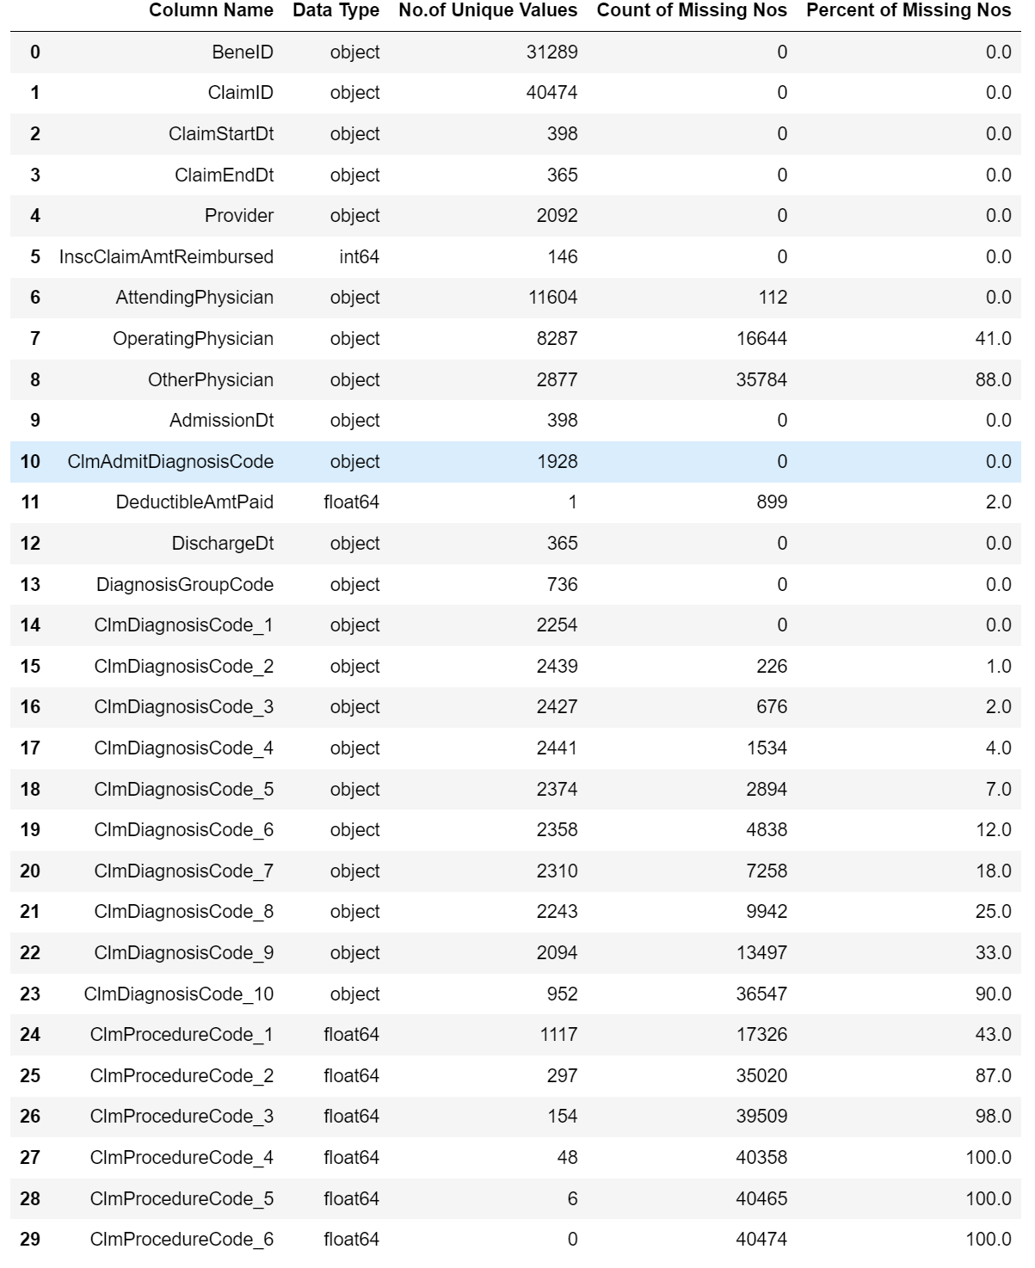
DATASET
Inpatient Dataset –
The inpatient dataset offers information on healthcare claims filed for Medicare patients admitted to hospitals.
Admission and discharge dates, admit diagnostic codes, and other information particular to patients' hospital stays are all relevant columns.
This dataset is critical for identifying possibly fraudulent actions inside hospital admissions by studying the patterns and features of inpatient claims.

Slide 7
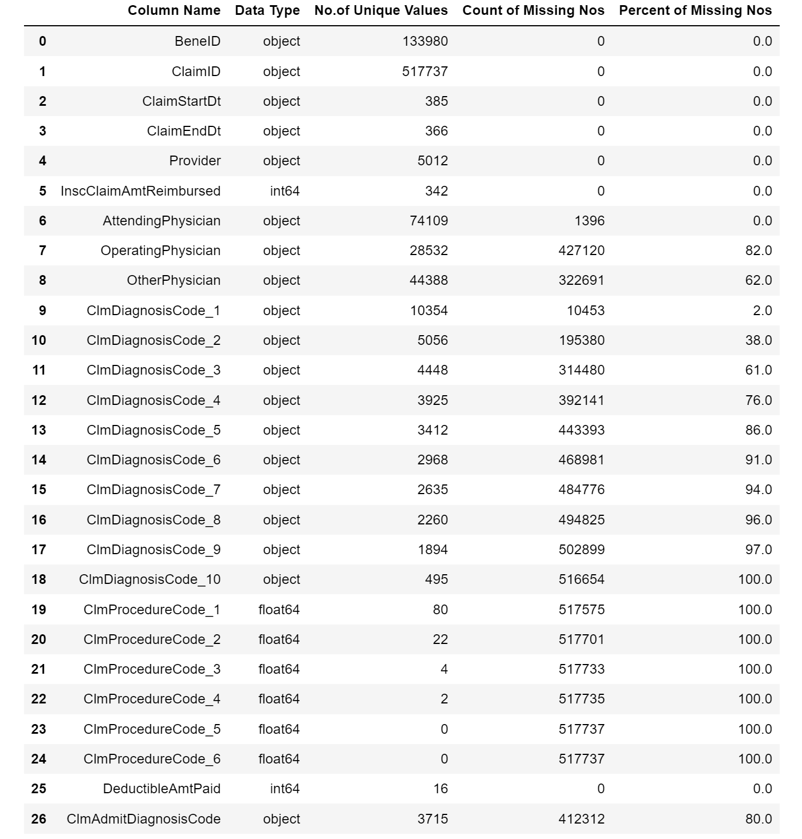
DATASET
Outpatient Dataset –
The outpatient dataset contains information on healthcare claims made by patients who visit hospitals but are not admitted.
Columns that stand out include information on procedures performed, diagnosis codes, dates of service, and associated expenditure.
Outpatient data analysis provides insights into patterns of service utilization, potential anomalies, and behaviors suggestive of fraudulent activity.

Slide 8
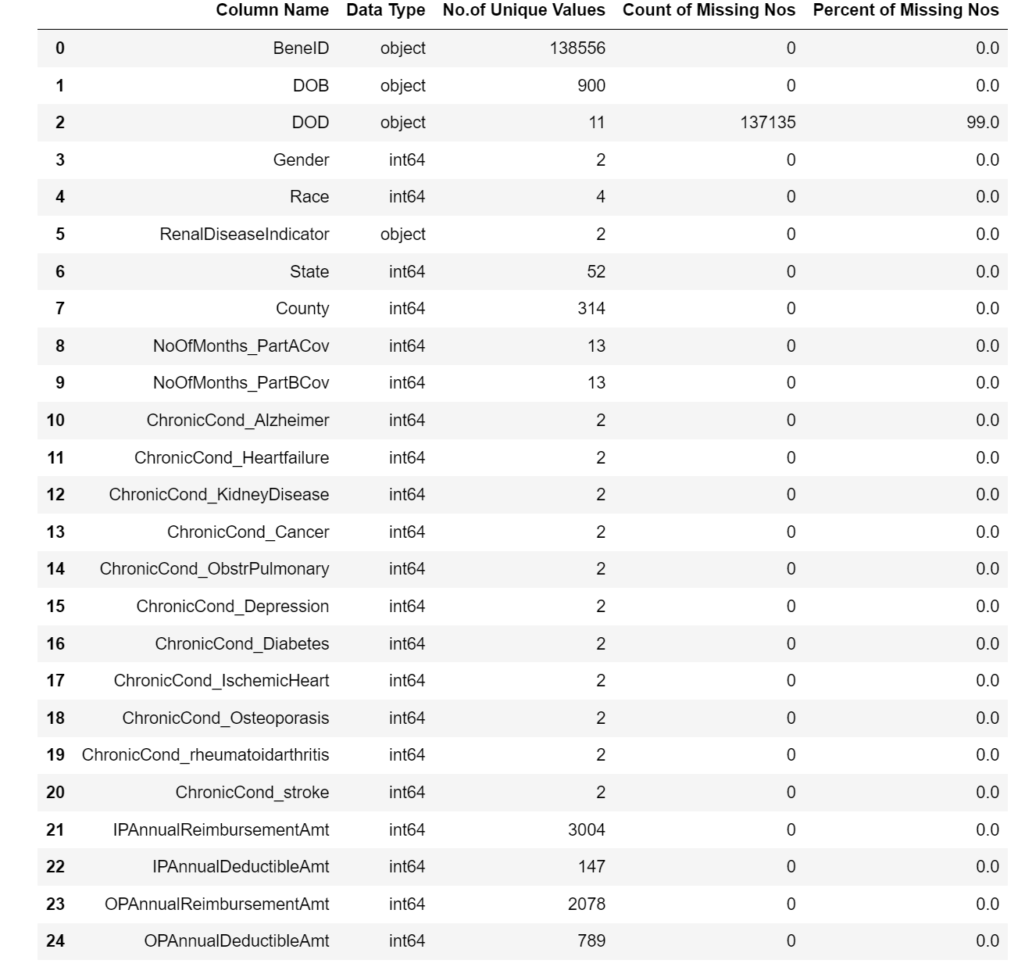
DATASET
Beneficiary Dataset –
Contains important KYC (Know Your Customer) information for Medicare beneficiaries.
There are columns for health conditions, area, date of birth (DOB), and date of death (DOD).
Provides critical demographic insights for understanding beneficiary characteristics and their impact on healthcare interactions.

Slide 9
METHODOLOGY
The Provider Fraud Detection Project's success is based on a well-defined methodology:
Loading and Preprocessing of Data:
The first dataset is loaded.
Filling in blanks and standardizing formats.
EDA (Exploratory Data Analysis):
Extensive investigation using descriptive statistics and visualizations.\
A foundation for developing hypotheses.
Feature Engineering:
Developing additional features to improve the forecasting capacity of the model.
Repurposing current features to gain valuable information.
Machine Learning Algorithm: -
The use of a specific algorithm for predictive modelling.
Algorithm selection based on dataset properties and project objectives.

Slide 10
METHODOLOGY
Start
Data Loading & Preprocessing
EDA
End
Feature Engineering
Machine Learning Algorithm

Slide 11
DATA EXPLORATION
Data exploration is the foundation of this Provider Fraud Detection Project, providing a deep understanding of the datasets.
This phase's key features include:
Extensive Exploration:
Extensive investigation to find patterns, trends, and probable outliers.
Making use of descriptive statistics to summarize significant traits.
Data Types and Properties:
Recognizing data kinds (numerical and categorical) and comprehending their distribution.
Dataset profiling to acquire insights into provider behavior, claim patterns, and beneficiary demographics.
Visualization Methods:
Using visualizations (histograms, box plots, and scatter plots) to depict data distributions and correlations.
Improving interpretability via visual representations.

Slide 12
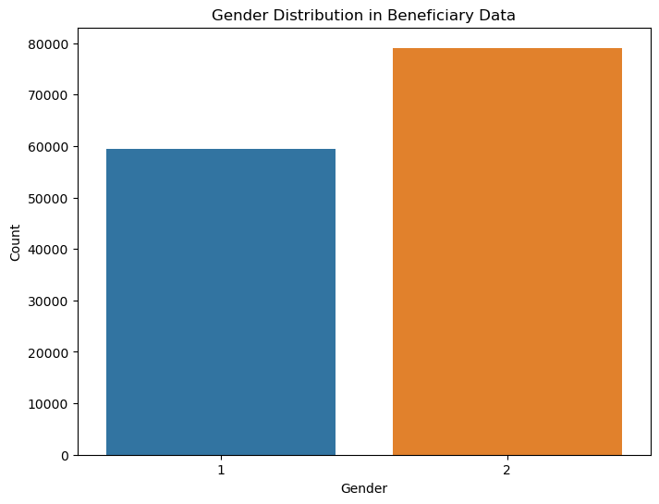
DATA EXPLORATION
The histogram depicts the gender distribution within the beneficiary dataset clearly.
The count of each gender category is represented by bars, providing for an easy comparison of male and female representation.

Slide 13
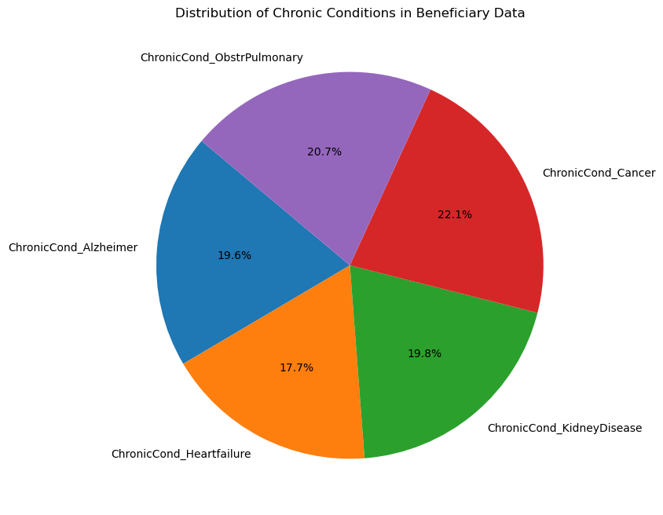
DATA EXPLORATION
The pie chart depicts the distribution of chronic illnesses among beneficiaries in a clear and visually appealing manner.
Each segment represents a different chronic ailment, and the different sizes show the percentage prevalence of each condition in the dataset.

Slide 14
FEATURE ENGINEERING
In order to improve the model's discerning capabilities, feature engineering is a crucial component of the Provider Fraud Detection Project. This phase's key features include:
Development of New Features:
Introducing features that include meaningful information.
Examples include hospital stay duration, frequency of claim filings, and beneficiary demographics.
Existing Feature Transformation:
Modifying existing features to get subtle insights.
As an example, consider transforming date data to determine the time between admission and discharge.
Goal:
The major goal is to supply the machine learning algorithm with more and more relevant data, hence improving its prediction capacity in detecting probable fraudulent behaviors.

Slide 15
CHOOSING ALGORITHM
For accurate fraud detection, an effective machine learning model must be implemented. This phase's key features include:
Algorithm Selection:
Choosing an algorithm that is compatible with the project's aims and dataset characteristics.
Popular alternatives include decision trees, random forests, logistic regression, and ensemble approaches.
Model Training:
Using a specific dataset, train the chosen method to understand patterns and relationships.
Ensuring that the model can generalise to new, previously unknown data.
Evaluation Metrics:
Using metrics such as accuracy, precision, recall, and F1 score to assess model performance.
Tailoring metrics to specific fraud detection goals, taking into account false positives and false negatives.
Iterative Refinement:
Refining the model iteratively by altering parameters and features.
Constant evaluation in order to adapt to changing patterns of fraudulent activity.

Slide 16
RESULTS
Now, Let’s evaluate the performance of our machine learning model in identifying possible scam providers:
Performance Metrics:
The effectiveness of our model is measured using important metrics such as accuracy, precision, recall, and F1 score. These measurements provide a full picture of its fraud detection performance.
We observed these indicators in our evaluation process by referring to the code.
Confusion Matrix:
The confusion matrix depicts the model's performance in terms of true positives, true negatives, false positives, and false negatives.
This matrix can be used to understand where the model thrives and where it may need to be refined further.

Slide 17
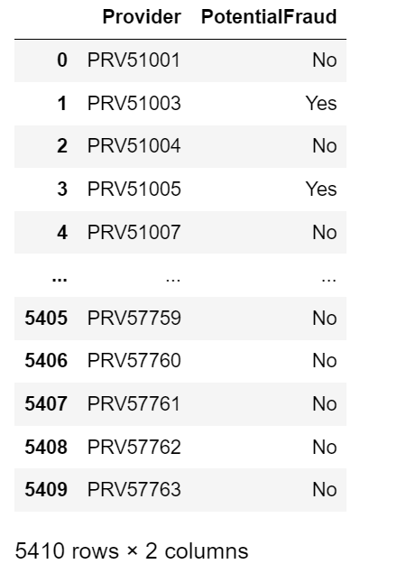
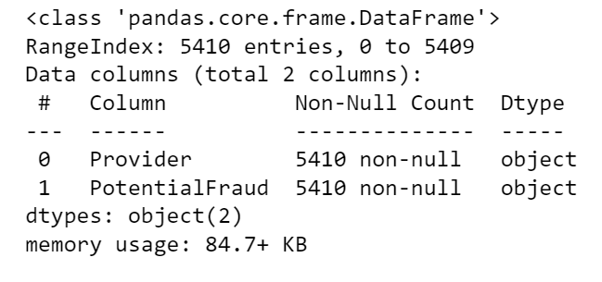
RESULTS

Slide 18
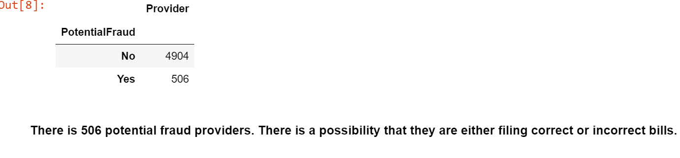
RESULTS

Slide 19
CHALLENGES
Data Quality Issues:
Variable data quality and completeness posed difficulties, affecting model reliability.
Imbalanced Dataset:
Dealing with imbalanced classes in fraud detection, which necessitates specialized management.
Complex Feature Engineering:
Creating meaningful features from raw healthcare data necessitates domain knowledge.
Interpreting Model Predictions:
Understanding machine learning model decisions presents interpretability issues.
Evolving Fraud Patterns:
Due to the dynamic nature of healthcare fraud, regular model changes and monitoring are required.

Slide 20
CONCLUSION
Through detailed data analysis, the research revealed important insights into healthcare fraud practices.
Despite the limitations, the machine learning model displayed excellent accuracy and predictive skills.
Recognizing the dynamic nature of healthcare fraud necessitates continual model development and updates.
The model's insights aid in informed decision-making and fraud prevention and risk mitigation.

Slide 21
THANK YOU
Stevens Institute of Technology
1 Castle Point Terrace, Hoboken, NJ 07030

